Slide 1

COLLEGE ADMISSION PORTAL

Slide 2

INTRODUCTION:
A Python Program for Humber College’s Admission Department.
Manages information about newly admitted students and allocate them to specific schools based on their GPA.
Features of the program:
Prompts the user to enter the password for access to Humber Admission Portal.
Asks the user to input the number of students, names of students and grades for each student for every course.
The program calculates the GPA as per the formula defined by the College Admission Department.
The Program automatically assigns the student to a particular school as per the specified criteria, based on the GPA.
Finally, it generates the required reports.

Slide 3
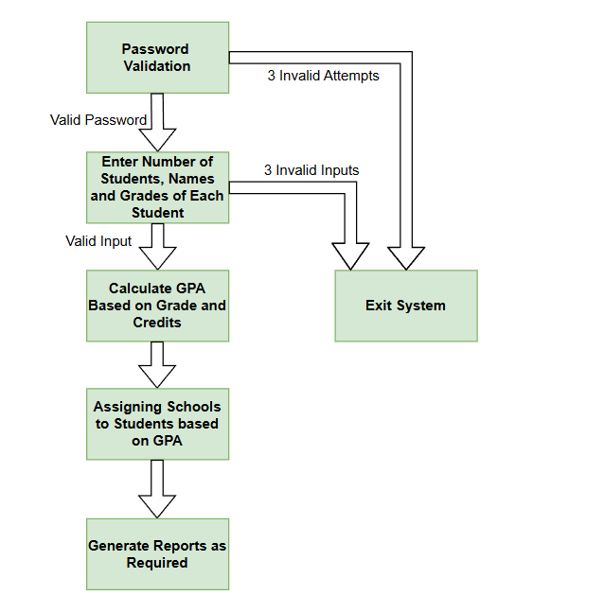
OVERVIEW OF THE PROGRAM

Slide 4

STEP 1:
PASSWORD VALIDATION

Slide 5
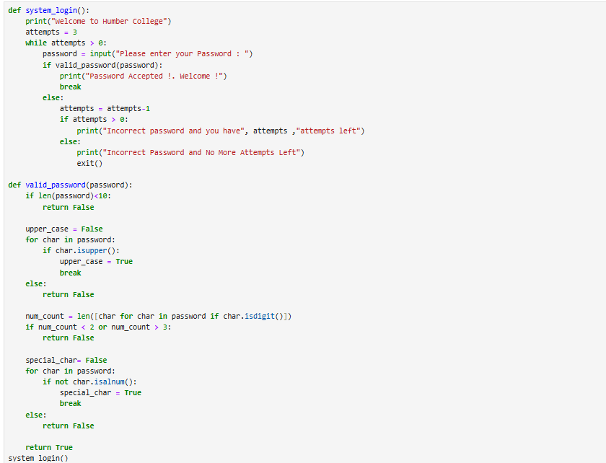
Step 1:
When we start, The Program will display "Welcome to Humber College".
Asks the User to enter their allocated password to proceed further.
To improve the security and to prevent unauthorized access, The user has maximum 3 login attempts, if he failed to login in these attempts the program will stop automatically.
To Strengthen password protection, We have used dedicated password conditions such as - At least 10 characters - Should contain at least one uppercase letter - Must include 2-3 digits - Should contain one special character

Slide 6

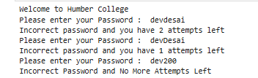
RESULTS:
Case 1:
Successful Attempt
Case 2:
Unsuccessful Attempts
Case 3:
Failed to Login

Slide 7

STEP 2 & 3 : STUDENT DATA COLLECTION AND GPA CALCULATION

Slide 8
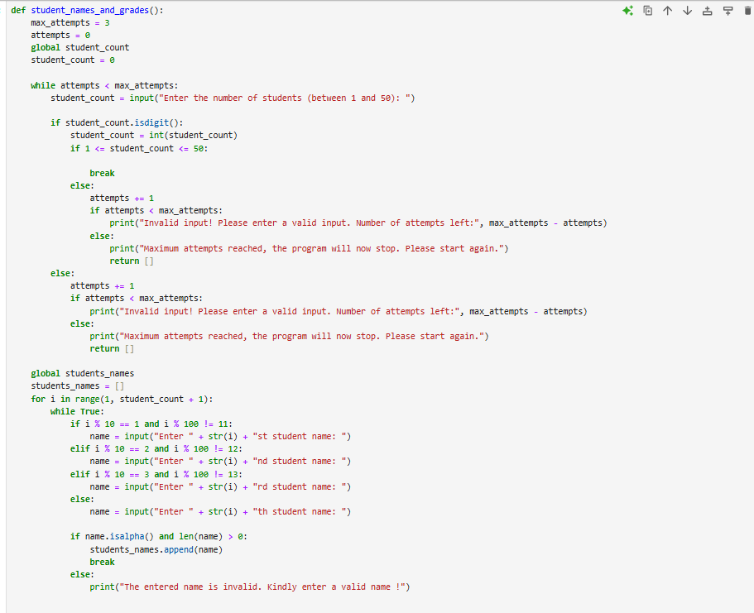
Step 2 and Step 3:
The program prompts the user to enter the number of students between 1 and 50.
Invalid input: the user gets three attempts to enter a valid one.
All 3 failed attempts: the program stops and displays an error message.
Valid Input: Proceeds with next step, where the user must enter students’ names and grades for every course.

Slide 9
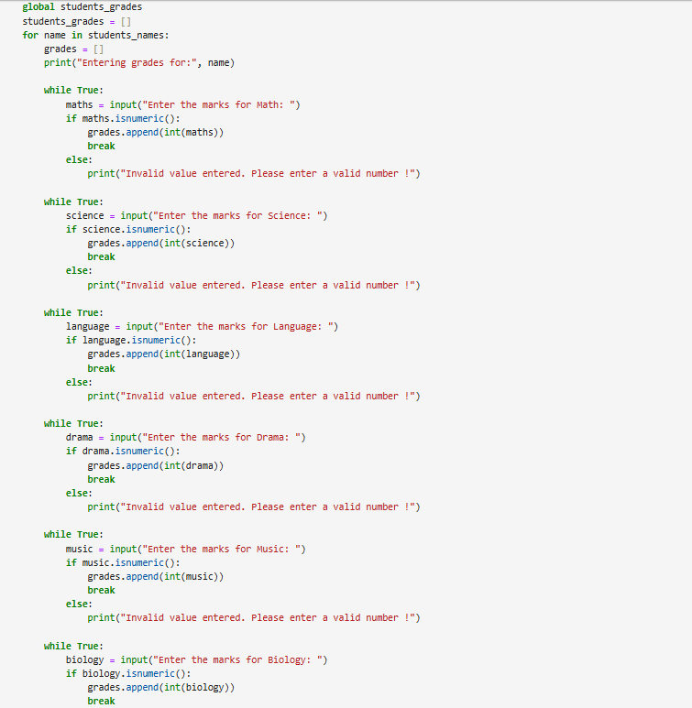
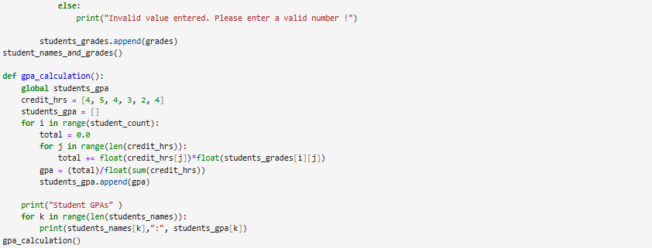
Step 2 and Step 3:
After the number of students is entered, the program prompts the user to enter the names of students.
Invalid Input : If the name entered is not a string alphabetic value, then the program asks the user to enter it again.
Valid Input : If the entered name is a string alphabetic value, the next step is to enter the marks of the students.
The marks entered for each student must be of integer datatype.
Invalid Input: If the marks are not of integer datatype, the program will ask the user to enter the marks again
Valid Input : If entered marks are of integer datatype, the program, then calculates and displays the GPA for every student based on the input of grades and already set credit hours by the admission department.
Weighted GPA is calculated for every student using the predefined formulae by the admission department.

Slide 10
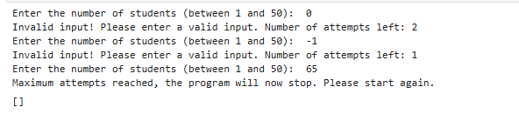
RESULTS:
Case 1:
Successful Attempt for entering the number of students
Case 2:
Unsuccessful Attempts
Case 3:
Failed Attempt

Slide 11

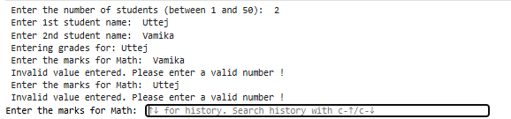
RESULTS:
Case 1:
Unsuccessful Attempts for entering the name of students
Case 2:
Unsuccessful attempt for entering marks of students

Slide 12
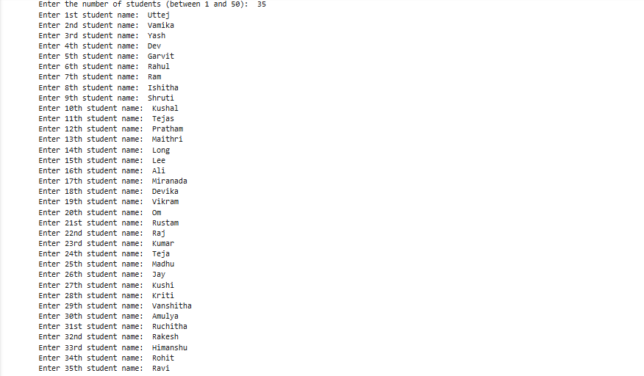
Case 3:
Successful Attempt for entering the names of students

Slide 13
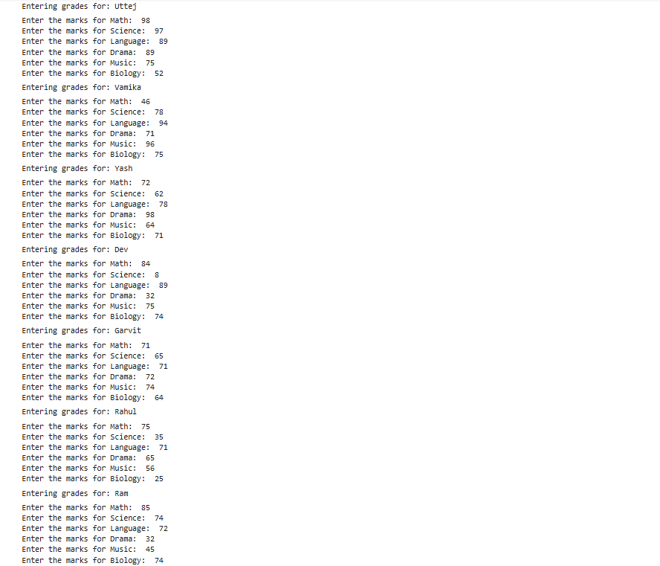
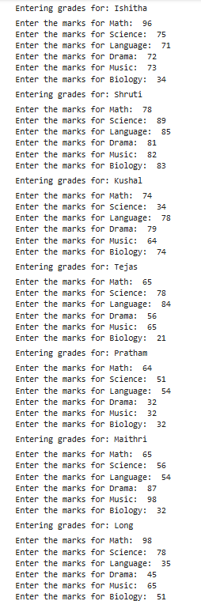
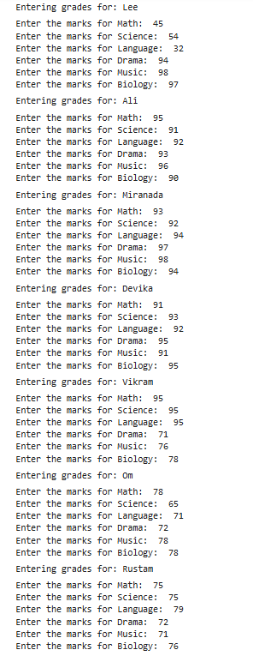
Case 4:
Successful Attempt of entering marks of students.

Slide 14
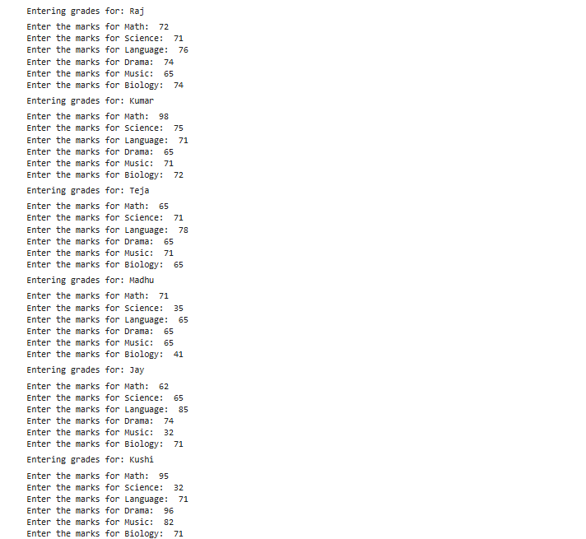
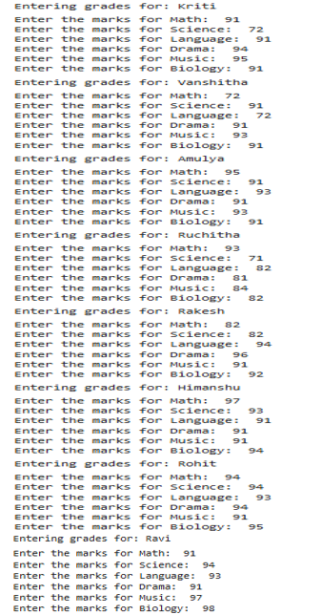
Case 4: (Continued)
Successful Attempt of entering marks of students.

Slide 15
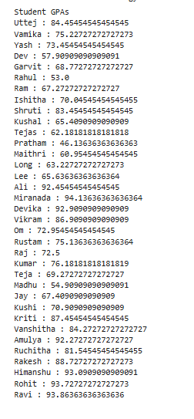
Case 4: (Continued)
Display names of students and the marks for every course along with the calculated GPA.

Slide 16

STEP 4 : ASSIGNING SCHOOL

Slide 17
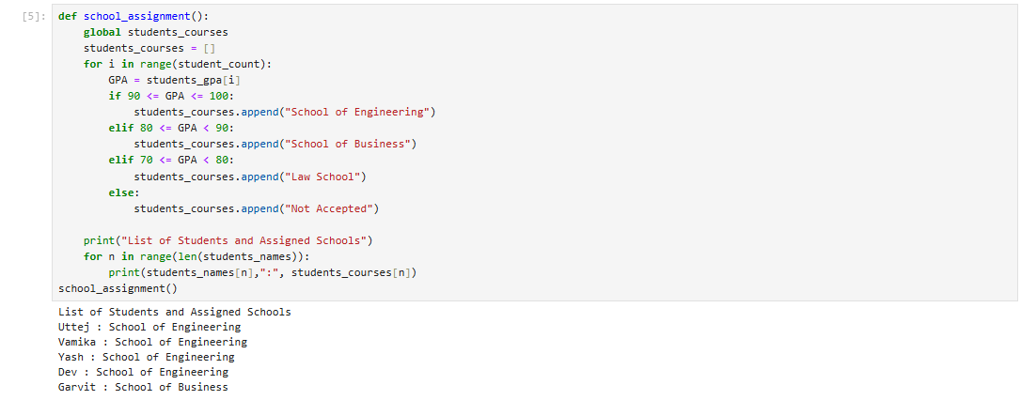
Step 4:
Based on the Calculated GPA, the program is going to assign students to schools based on pre-defined criteria
GPA | Schools
90-100 | School of Engineering
80-89 | School of Business
70-79 | Law School
Below 70 | Not Accepted

Slide 18
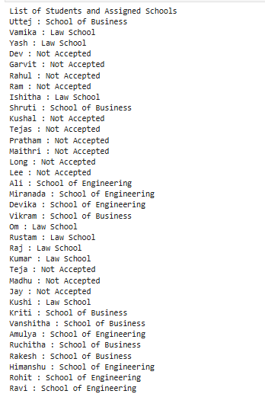
RESULT:
The names of the students along with the assigned schools

Slide 19

STEP 5 : REPORT GENERATION

Slide 20
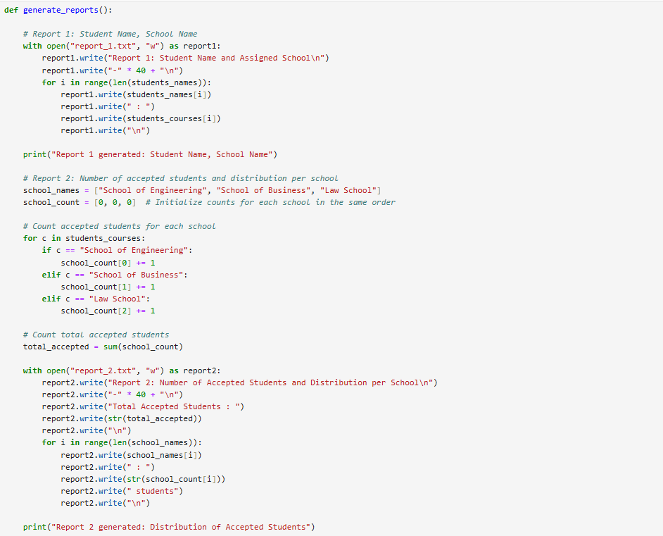
Step 5:
In the end, the program generates 4 reports as text files to make it more accessible and human-readable.
All Students with their Assigned status
Number of Accepted students and Distribution per School
Total Number of Students Not Accepted
Students with GPA > 90.

Slide 21
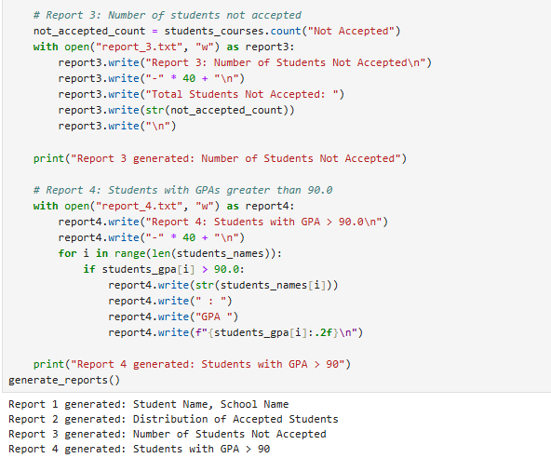

Student Names and Assigned Schools : This report contains a list of student names with the schools they have been assigned, if a student has not been assigned to any of the school, it will be shown as "Not Accepted".
Number of Students Accepted and Distribution per school This report provides an overview of how many students are being assigned to each school. This report helps to identify schools with more students and less students so that the school can allocated resources and staff.
Total Number of Students not accepted This report helps in finding the count of students who has GPA less than 70 percent and not being accepted to any of the schools.
Students with GPA > 90 This report helps in identifying the list of students who have GPA of 90 or higher and helps in tracking toppers in schools to check eligibility for any special programs.

Slide 22
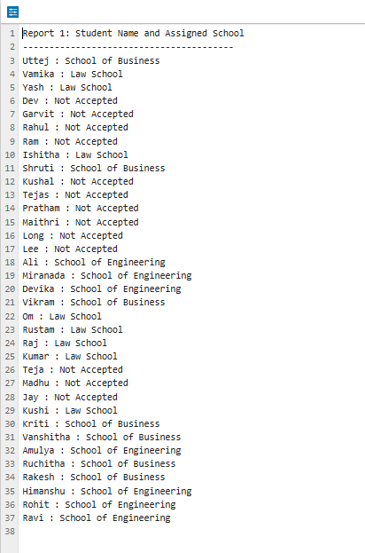
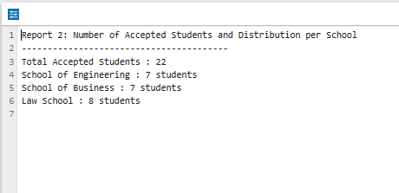
RESULT: 4 Generated Reports

Slide 23
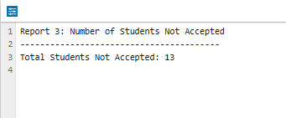
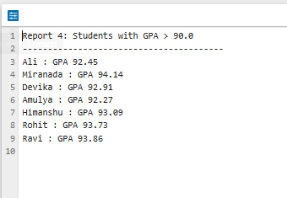
RESULT: 4 Generated Reports

Slide 24


